Slide 1
AFTERWORK DATA SCIENCE
PYTHON FOR DATA ANALYSIS

Slide 2
OVERALL AGENDA
1HR 45 MIN | Session 1: Python for Data Analysis
10 MIN | Break
1HR 45 MIN | Session 2: Data Analysis Project with Python

Slide 3
AGENDA
5 MIN | Introduction + Learning Outcomes
20 MIN | Topic Introduction
1HR 10MIN | Practice Time!
5 MIN | Q/A + Checkout Form

Slide 4
LEARNING OUTCOMES
I can import datasets from csv and excel files for data analysis.
I can perform data exploration techniques to understand data.
I can perform filtering and sorting to select desired records.
I can use aggregate functions to perform calculations on a set of records.
I can create pivot tables to summarize a dataset.

Slide 5
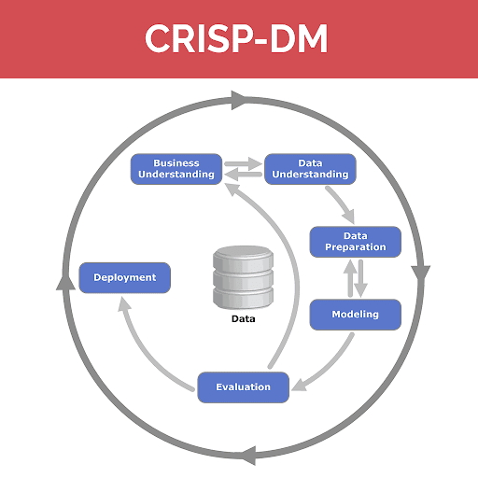
OVERVIEW
Data Analysis
Data analysis is used in business to help organizations make better business decisions.
The process of data analysis uses analytical and logical reasoning to gain information from the data.
Types of Data Analysis
Descriptive Analysis
Diagnostic Analysis
Predictive Analysis
Prescriptive Analysis

Slide 6
OVERVIEW
Descriptive Analysis
Descriptive data analysis looks at past data and tells what happened. This is often used when tracking Key Performance Indicators (KPIs), revenue, sales leads, and more.
Diagnostic Analysis
Diagnostic data analysis aims to determine why something happened. Once your descriptive analysis shows that something negative or positive happened, diagnostic analysis can be done to figure out the reason.
Predictive Analysis
Predictive data analysis predicts what is likely to happen in the future. In this type of research, trends are derived from past data which are then used to form predictions about the future.
Prescriptive Analysis
Prescriptive data analysis combines the information found from the previous 3 types of data analysis and forms a plan of action for the organization to face the issue or decision.

Slide 7
PYTHON TOOLS
Why Python?
Libraries
Pandas Library
For data manipulation and analysis
Numpy Library
For performing scientific computations.
Matplotlib Library
For creating visualisations.
Seaborn Library
For creating rich data visualisations.

Slide 8
LOADING DATASETS
Types of Datasets
Load CSV Files
Load Excel Files
Load SQL Files
Sources
Load from URL
Load from Local Machine
Load from Server
Load from Cloud Storage i.e. Google Drive
Datasets are saved into a dataframe, which is a two dimensional tabular data structure.

Slide 9
PERFORMING DATA EXPLORATION
Determining No. of Records and Columns/Variables
Previewing First few records
i.e First 5 Records
Previewing Last few records
i.e Last 5 Records
Getting a Sample of records
i.e Sample 10 Records
Data Types
Floating point number, Integers, Strings
Bivariate Analysis
Correlation Coefficient: Statistical measure that calculates the strength of the relationship between two variables.

Slide 10
FILTERING AND SORTING
Select records
Select records and apply a condition
Sort records in ascending or descending order

Slide 11
AGGREGATE FUNCTIONS
Aggregate functions are functions that perform calculations on a set of values, and return a single value.
Examples:
sum()
min()
max()
mean()
mode()
median()
describe()

Slide 12
PIVOT TABLES
These are tables that summarize data that is stored in a large table.
pivot_table()

Slide 13
PRACTICE: 1HR 20MIN
Practice Notebook http://bit.ly/PDANotebook
Notes:
http://bit.ly/PDANotebook

Slide 14
Python Notebook
https://bit.ly/PythonNotebookSW

Slide 15
Data Visualisation with Matplotlib
https://bit.ly/3x3qdC8

Slide 16
CHECK OUT FORM
Feedback Form https://bit.ly/DTSAFeedbackForm Outline https://bit.ly/FellowshipOutline Youtube https://bit.ly/AfterworkYoutube valentine@afterwork.ai
Data Analysis and Reporting with Python

